Slide 1
Analyzing Algorithms
Session 03
Nikita Ananda Putri Masaling, S.Kom., M.Kom.

Slide 2
Outline materials
Session 3
RAM Model of Computation
Insertion Sort as a Running Example
Worst-Case, Average-Case, and Best-Case Analysis
Order of Growth — Informal Complexity Arguments

Slide 3
Learning Outcomes
Session 3
By the end of this session, students will be able to:
LO 1: Evaluate the time and space complexity of algorithms using asymptotic notation and formal analysis methods, and prove algorithm correctness using loop invariants, induction, or exchange arguments.

Slide 4
RAM Model of Computation
Why we need a Model?
To analyze an algorithm's running time, we need a model of the computing machine that is:
  Simple enough to be mathematically tractable.
  Powerful enough to reflect real-machine performance.
The Random Access Machine (RAM) model serves this purpose

Slide 5
RAM Model of Computation
RAM Model Assumptions
Instructions execute one at a time (no concurrency).
Each of the following takes one time step (unit cost):
  Arithmetic: +, −, ×, /, mod, floor, ceiling.
  Data movement: assignment, load, store.
  Control: conditional and unconditional branch, subroutine call and return.
Each memory access (read or write of a single word) takes one step.
Data types: integers and floating-point numbers, each fitting in one word of memory. We do not model overflow.

Slide 6
RAM Model of Computation
RAM Model Assumptions
The RAM model gives a clean worst-case upper bound that closely predicts real performance up to constant factors for most algorithms on modern hardware.

Slide 7
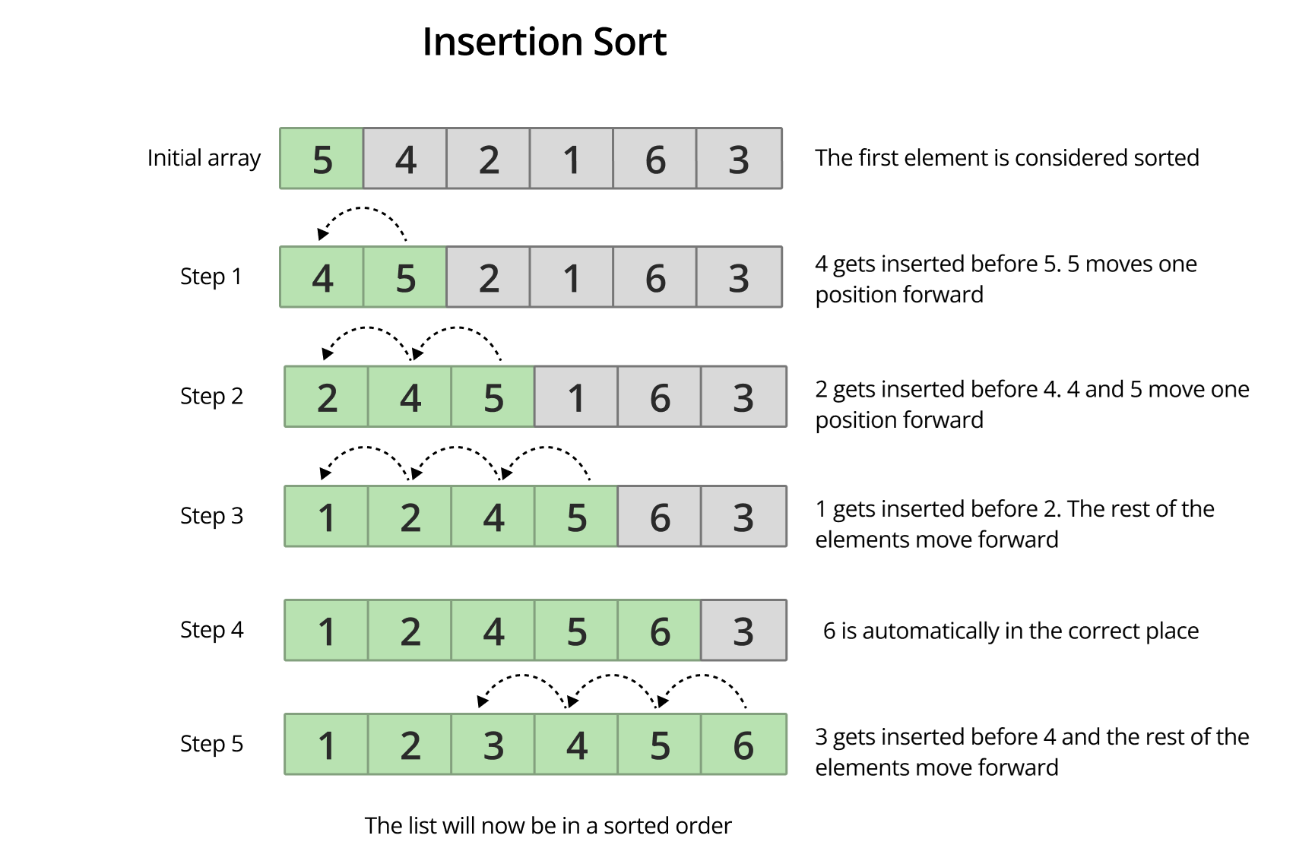
Insertion sort Analysis
The Intuition

Slide 8
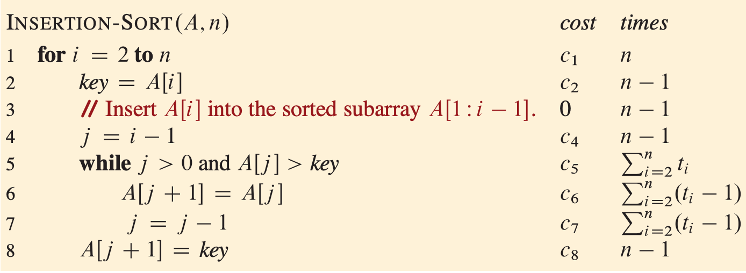
Insertion sort Analysis
The algorithm
Let $t_{i}=$ number of times the while-loop condition is evaluated in iteration $i$ of the outer for-loop. So $t_{i}$ is tied to iteration $i.$

Slide 9
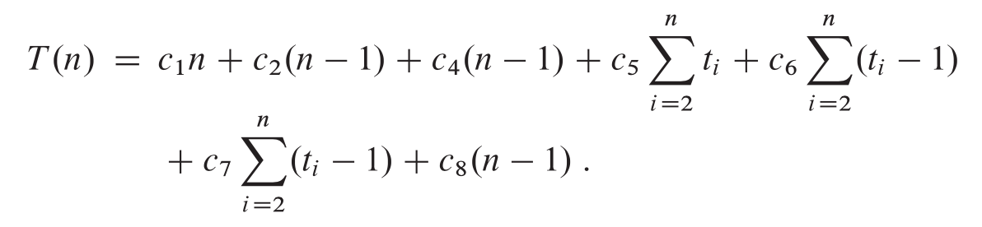
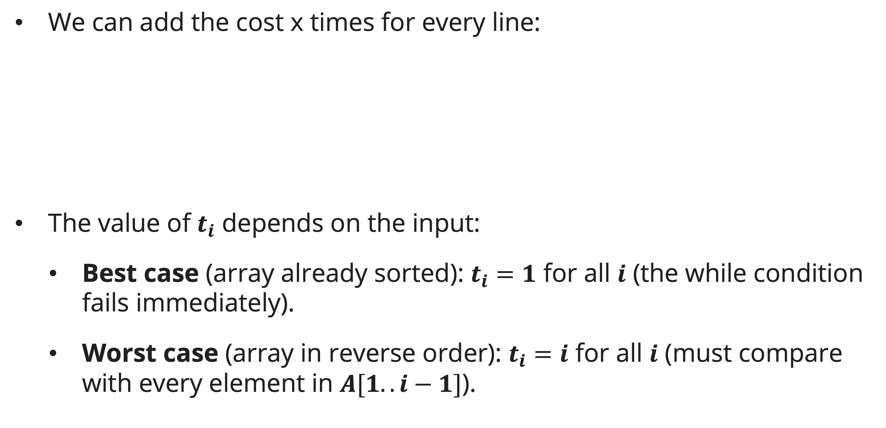
Insertion sort Analysis
Exact Running times
We can add the cost x times for every line:
The value of $t_{i}$ depends on the input:
  Best case (array already sorted): $t_{i}=1$ for all $i$ (the while condition fails immediately).
  Worst case (array in reverse order): $t_{i}=i$ for all $i$ (must compare with every element in $A[1..i−1]$).

Slide 10
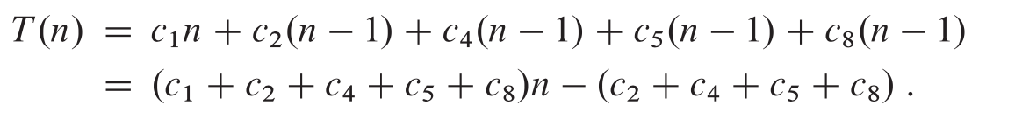

Worst-Case, Average-Case, and Best-Case Analysis
Best-Case Analysis (Already Sorted Input)
With $t_{i} = 1 for all i$:
This is a linear function of n: $T(n) = an + b$for constants $a$ ($c1+c2+c4+c5+c8$) and $b$ ($c2+c4+c5+c8$).

Slide 11
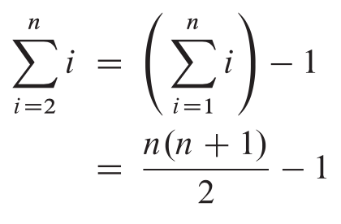
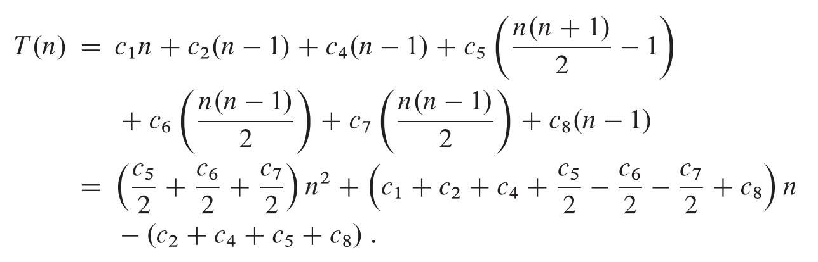
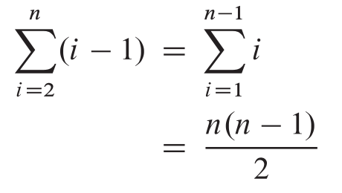

Worst-Case, Average-Case, and Best-Case Analysis
Worst-Case Analysis (Reverse-Sorted Input)
With $t_{i} = i$:
This is a quadratic function of n: $T\left(n\right)= an^{2} + bn+c$

Slide 12
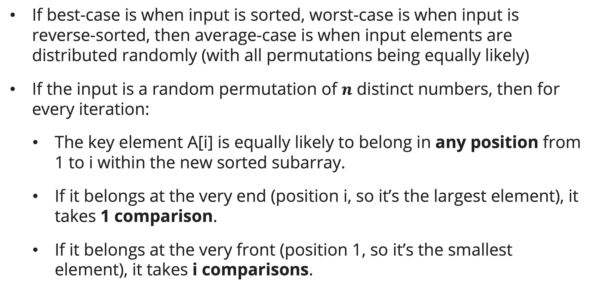
Worst-Case, Average-Case, and Best-Case Analysis
Average-Case Analysis
If best-case is when input is sorted, worst-case is when input is reverse-sorted, then average-case is when input elements are distributed randomly (with all permutations being equally likely)
If the input is a random permutation of $n$ distinct numbers, then for every iteration:
  The key element A[i] is equally likely to belong in any position from 1 to i within the new sorted subarray.
  If it belongs at the very end (position i, so it’s the largest element), it takes 1 comparison.
  If it belongs at the very front (position 1, so it’s the smallest element), it takes i comparisons.

Slide 13
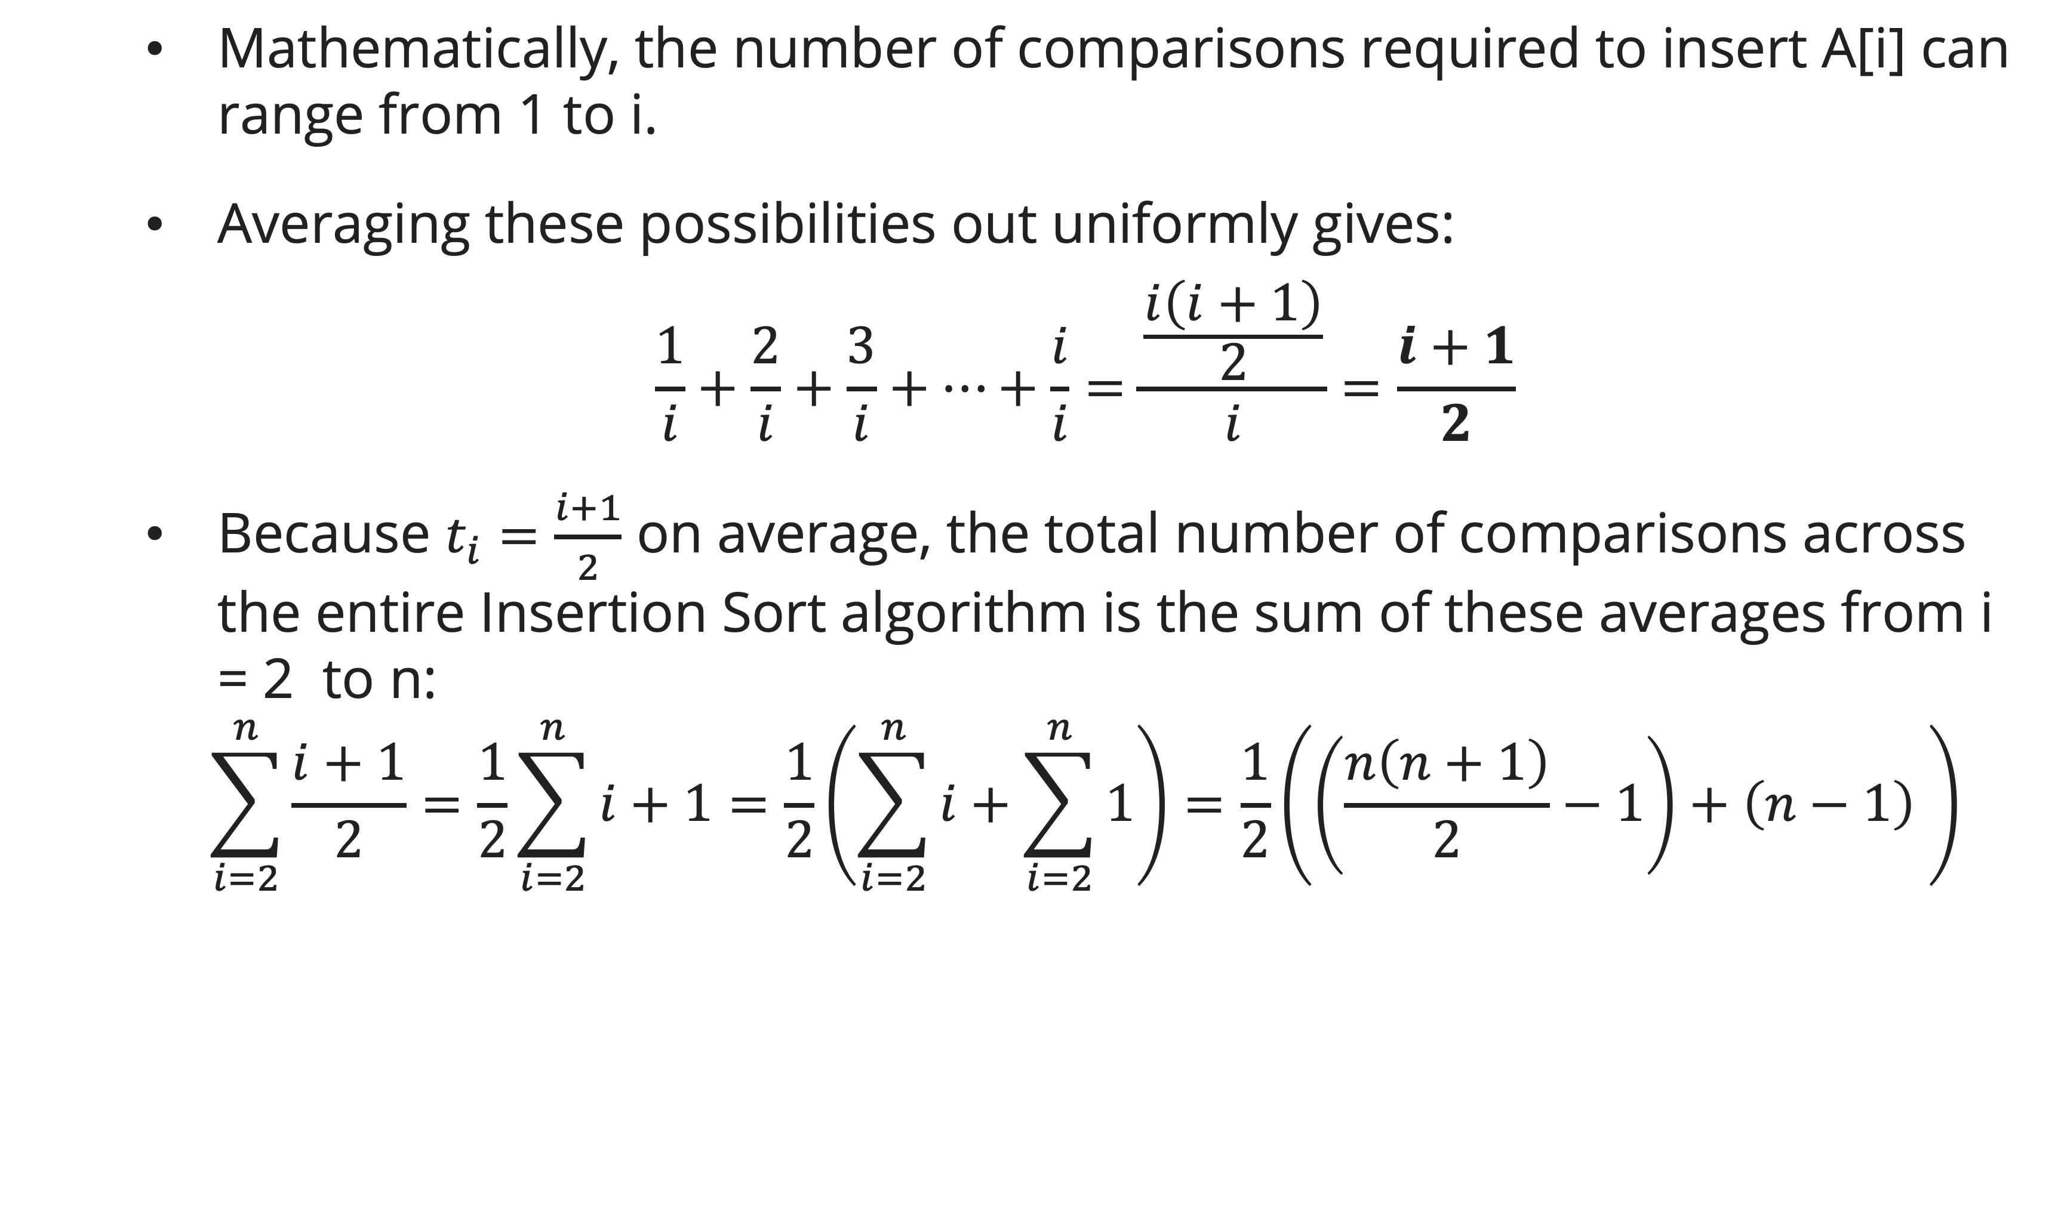
Worst-Case, Average-Case, and Best-Case Analysis
Average-Case Analysis
Mathematically, the number of comparisons required to insert A[i] can range from 1 to i.
Averaging these possibilities out uniformly gives:
$$\frac{1}{i}+\frac{2}{i}+\frac{3}{i}+…+\frac{i}{i}=\frac{\frac{i\left(i+1\right)}{2}}{i}=\frac{i+1}{2}$$
Because $t_{i}=\frac{i+1}{2}$ on average, the total number of comparisons across the entire Insertion Sort algorithm is the sum of these averages from i = 2 to n:
$$\sum_{i=2}^{n}{\frac{i+1}{2}}=\frac{1}{2}\sum_{i=2}^{n}{i+1}=\frac{1}{2}\left(\sum_{i=2}^{n}{i}+\sum_{i=2}^{n}{1}\right)=\frac{1}{2}\left(\left(\frac{n\left(n+1\right)}{2}−1\right)+\left(n−1\right) \right)$$

Slide 14
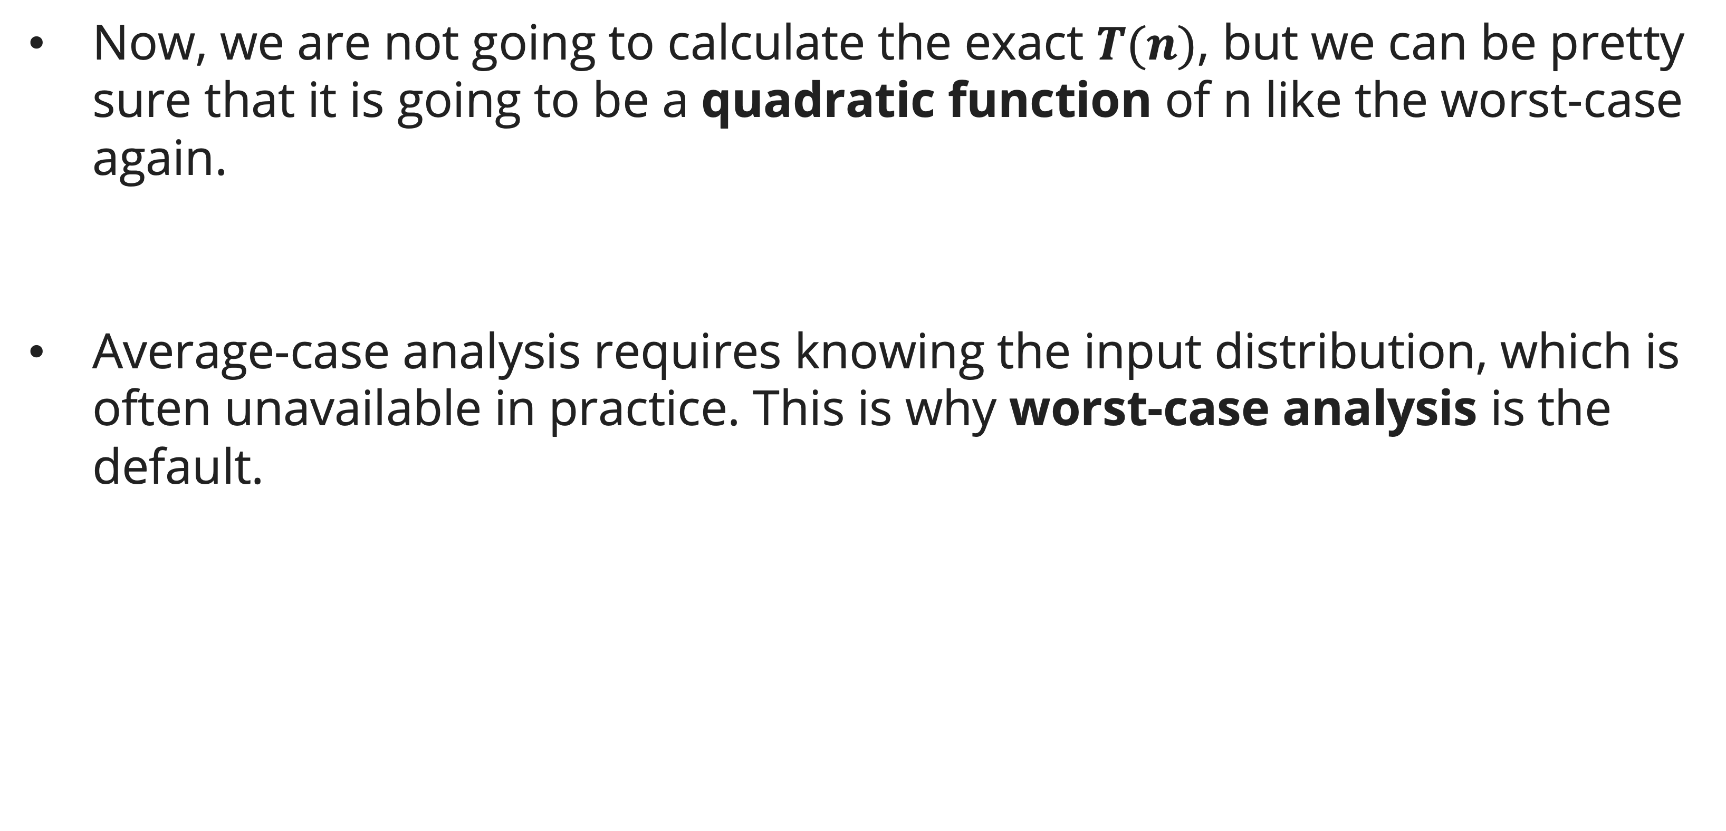
Worst-Case, Average-Case, and Best-Case Analysis
Average-Case Analysis
Now, we are not going to calculate the exact $T(n)$, but we can be pretty sure that it is going to be a quadratic function of n like the worst-case again.
Average-case analysis requires knowing the input distribution, which is often unavailable in practice. This is why worst-case analysis is the default.

Slide 15
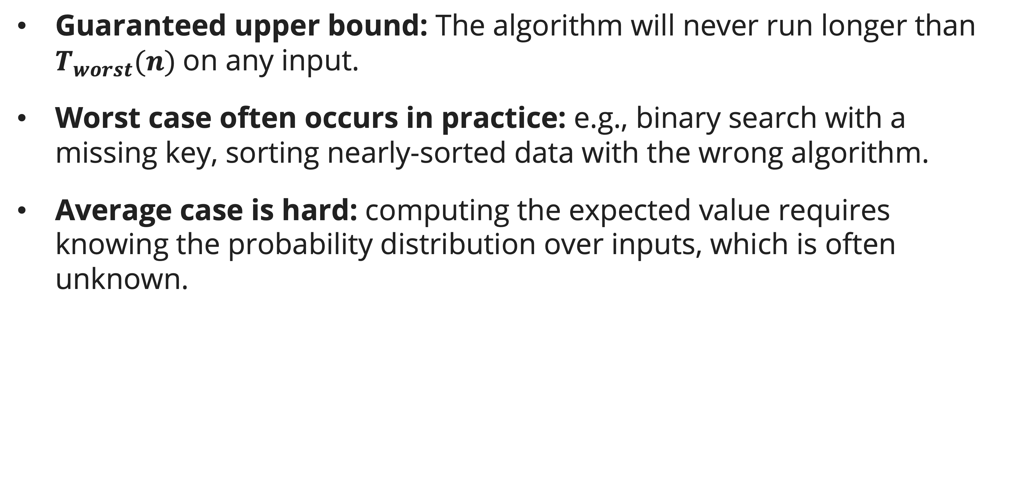
Worst-Case, Average-Case, and Best-Case Analysis
Why Worst-Case is Preferred
Guaranteed upper bound: The algorithm will never run longer than $T_{worst}(n)$on any input.
Worst case often occurs in practice: e.g., binary search with a missing key, sorting nearly-sorted data with the wrong algorithm.
Average case is hard: computing the expected value requires knowing the probability distribution over inputs, which is often unknown.

Slide 16
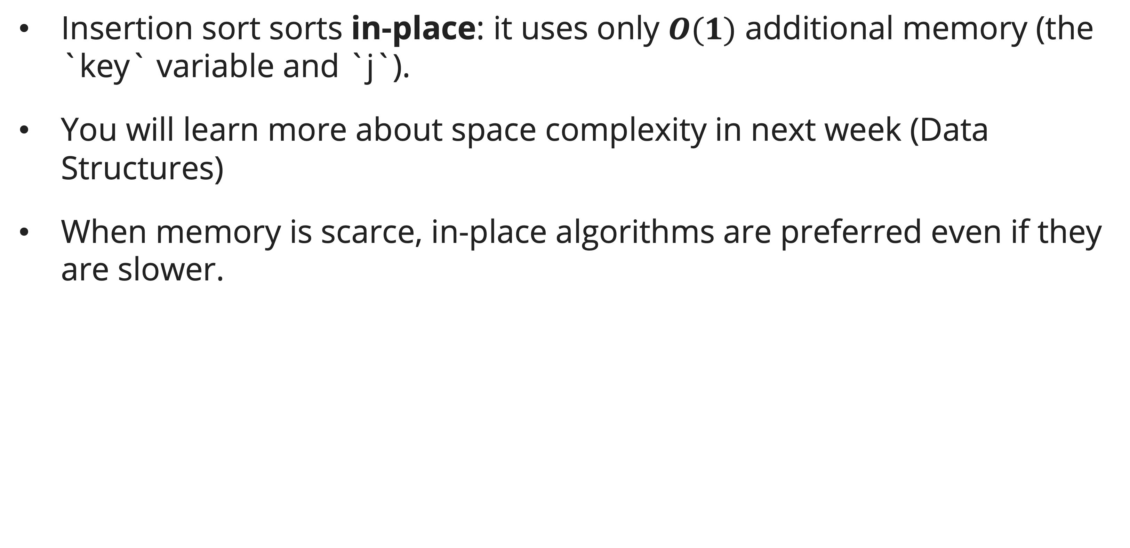
Worst-Case, Average-Case, and Best-Case Analysis
Space Complexity
Insertion sort sorts in-place: it uses only $O(1)$ additional memory (the `key` variable and `j`).
You will learn more about space complexity in next week (Data Structures)
When memory is scarce, in-place algorithms are preferred even if they are slower.

Slide 17
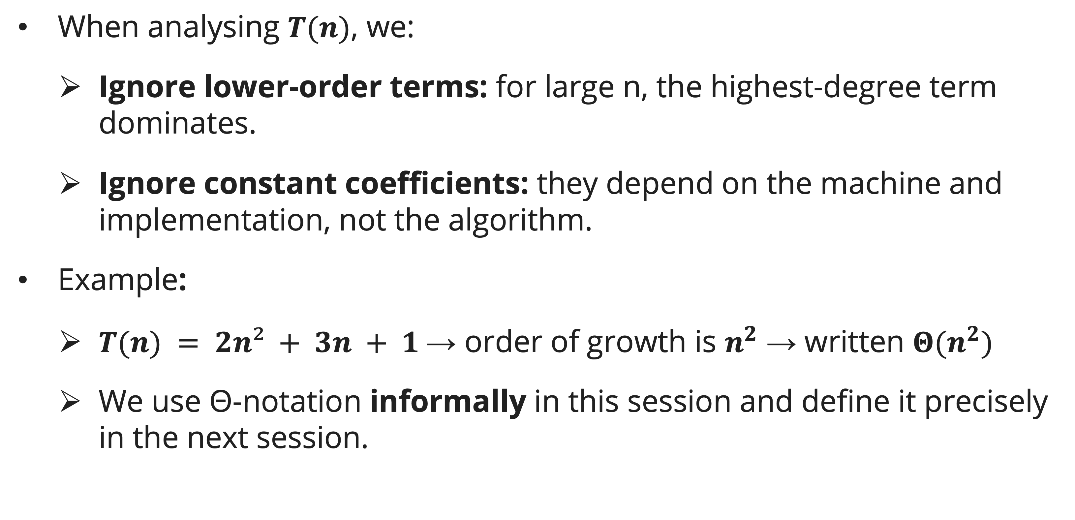
Order of growth
Simplifying Running time
When analysing $T(n)$, we:
  Ignore lower-order terms: for large n, the highest-degree term dominates.
  Ignore constant coefficients: they depend on the machine and implementation, not the algorithm.
Example:
  $T(n) = 2n² + 3n + 1$→ order of growth is $n^{2}$ → written $Θ(n^{2})$
  We use Θ-notation informally in this session and define it precisely in the next session.

Slide 18
Order of growth
Simplifying Running time
This simplification is justified because:
  For sufficiently large n, the lower-order terms contribute < 1% of the total.
  The constant factor merely scales the function vertically — it does not change the fundamental growth behaviour.

Slide 19
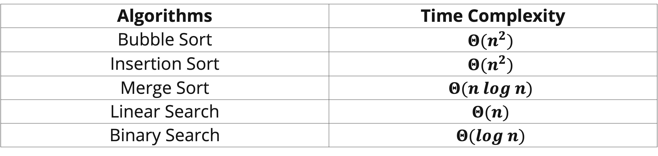
Order of growth
Time complexity of known algorithms (You have learned these!)
Algorithms | Time Complexity
Bubble Sort | $$Θ(n^{2})$$
Insertion Sort | $$Θ(n^{2})$$
Merge Sort | $$Θ(n log n)$$
Linear Search | $$Θ(n)$$
Binary Search | $$Θ(log n)$$
For now, at least bubble sort, insertion sort, and linear search should be obvious.
We will cover how to calculate time complexity of merge sort and
binary search in future sessions!

Slide 20
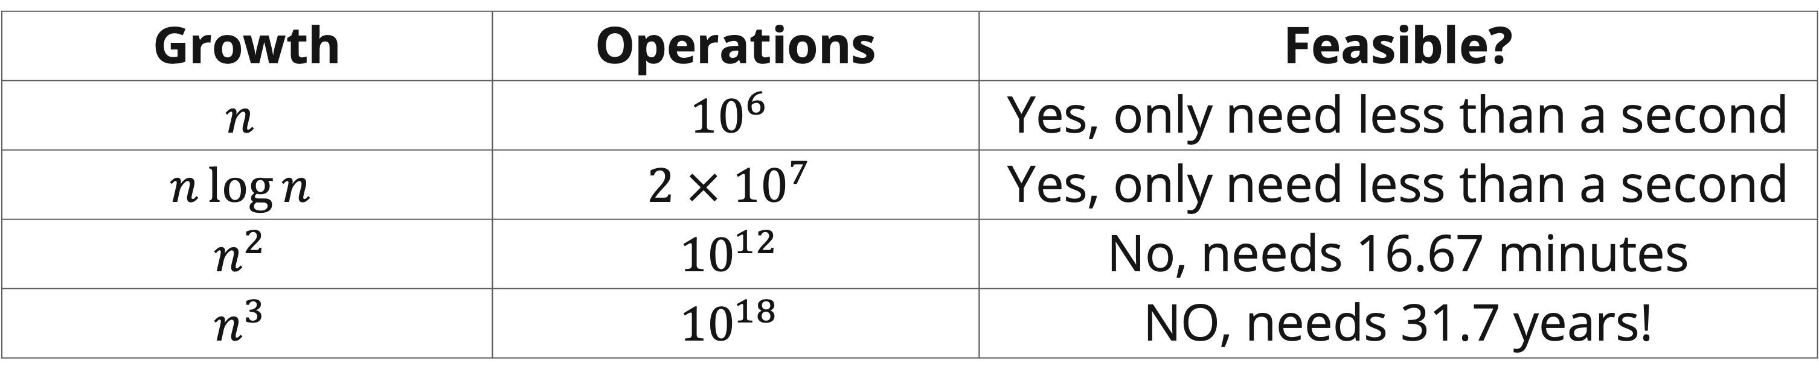

Order of growth
Order of growth (or rates of growth) illustrated
Let’s say we have input size $n={10}^{6}$ and our computer processing speed is ${10}^{9}/s$
The difference between $Θ(n log⁡n)$and $Θ(n^{2})$is the difference between a working production system and one that times out.
Growth | Operations | Feasible?
$$n$$ | $${10}^{6}$$ | Yes, only need less than a second
$$n\log{n}$$ | $$2 × {10}^{7}$$ | Yes, only need less than a second
$$n^{2}$$ | $${10}^{12}$$ | No, needs 16.67 minutes
$$n^{3}$$ | $${10}^{18}$$ | NO, needs 31.7 years!

Slide 21
Order of growth
Input Size Conventions
For sorting: input size = number of elements n.
For graphs: input size = number of vertices V and edges E.
For strings: input size = string length.
For arithmetic: input size = number of bits in the input number (relevant for big-number computations).

Slide 22
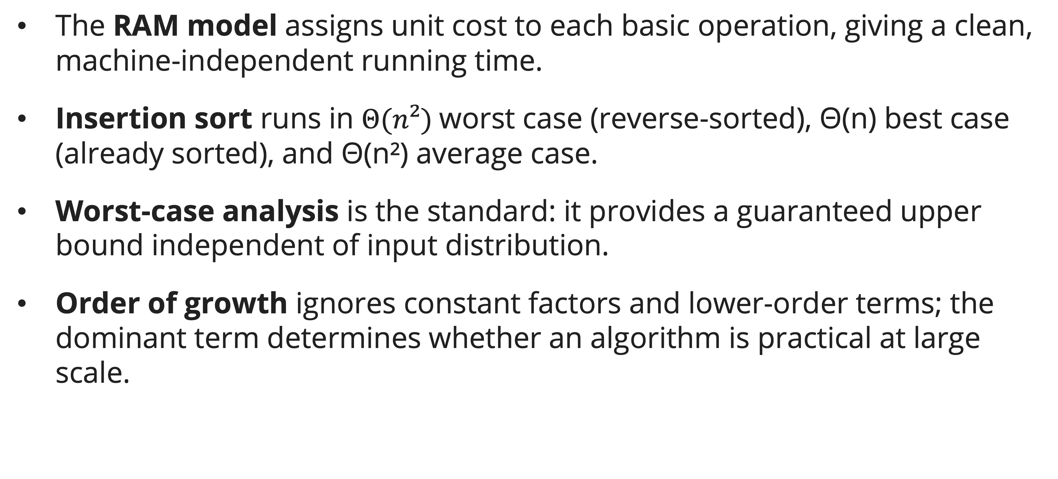
Summary
Session 3
The RAM model assigns unit cost to each basic operation, giving a clean, machine-independent running time.
Insertion sort runs in $Θ(n²)$worst case (reverse-sorted), Θ(n) best case (already sorted), and Θ(n²) average case.
Worst-case analysis is the standard: it provides a guaranteed upper bound independent of input distribution.
Order of growth ignores constant factors and lower-order terms; the dominant term determines whether an algorithm is practical at large scale.

Slide 23
Exercises
Session 3
Consider the searching problem:
  Input: A sequence of n numbers [a1, a2, …, an] stored in array A[1:n] and a value x.
  Output: An index I such that x equals A[i] or the special value NIL if x does not appear in A.
  Write pseudocode for linear search, which scans through the array from beginning to end, looking for x. Using a loop invariant, prove that your algorithm is correct. Make sure that your loop invariant fulfills the three necessary properties.
Consider linear search again. How many elements of the input array need to be checked on the average, assuming that the element being searched for is equally likely to be any element in the array? How about in the worst case?
  Using Θ-notation, give the average-case and worst-case running times of linear search. Justify your answer.

Slide 24
Exercises
Session 3
Consider linear search again. How many elements of the input array need to be checked on the average, assuming that the element being searched for is equally likely to be any element in the array? How about in the worst case?
  Using Θ-notation, give the average-case and worst-case running times of linear search. Justify your answer.

Slide 25
References
Session 3
Cormen, T.H., Leiserson, C.E., Rivest, R.L., & Stein, C. (2022). Introduction to Algorithms, 4th Edition. MIT Press. Ch. 2.2
Skiena, S.S. (2020). The Algorithm Design Manual, 3rd Edition. Springer. Ch. 2.1, Ch. 2.5

